Slide 1
Sorting Algorithms
Miraga Aliyev – Heap Sort;
Zivar Hasanova – Insertion Sort;
Gunel Khanaliyeva– Selection Sort;
Javidan Alizada – Merge Sort;
Will Present You:

Slide 2
Sorting Algorithms
Heap Sort;
Heap sort is a sorting technique based on Binary Heap data structure. It is similar to the selection sort where we first find the minimum element and place the minimum element at the beginning. Repeat the same process for the remaining elements.
Will Present You:
How it works?
Miraga Aliyev – Heap Sort;
Zivar Hasanova – Insertion Sort;
Build a heap from the given input array.
Repeat the following steps until the heap contains only one element:
Swap the root element of the heap (which is the largest element) with the last element of the heap.
Remove the last element of the heap.
Heapify the remaining elements of the heap.
The sorted array is obtained by reversing the order of the elements in the input array.
Gunel Khanaliyeva– Selection Sort;
Javidan Alizada – Merge Sort;

Slide 3
Will Present You:
Miraga Aliyev
Heap Sort;
Heap sort is a sorting technique based on Binary Heap data structure. It is similar to the selection sort where we first find the minimum element and place the minimum element at the beginning. Repeat the same process for the remaining elements.
How it works?
Miraga Aliyev – Heap Sort;
Zivar Hasanova – Insertion Sort;
Build a heap from the given input array.
Repeat the following steps until the heap contains only one element:
Swap the root element of the heap (which is the largest element) with the last element of the heap.
Remove the last element of the heap.
Heapify the remaining elements of the heap.
The sorted array is obtained by reversing the order of the elements in the input array.
Gunel Khanaliyeva– Selection Sort;
Javidan Alizada – Merge Sort;
Let’s Start With
4
10
3
5
1

Slide 4
Heap Sort;
Heap sort is a sorting technique based on Binary Heap data structure. It is similar to the selection sort where we first find the minimum element and place the minimum element at the beginning. Repeat the same process for the remaining elements.
How it works?
Build a heap from the given input array.
Repeat the following steps until the heap contains only one element:
Swap the root element of the heap (which is the largest element) with the last element of the heap.
Remove the last element of the heap.
Heapify the remaining elements of the heap.
The sorted array is obtained by reversing the order of the elements in the input array.
Let’s Start With
4
10
3
5
1

Slide 5
Let’s Start With
4
10
3
5
1

Slide 6
Max Heapify
10
4
3
5
1

Slide 7
Max Heapify
10
5
3
4
1

Slide 8
Swap And Remove
1
5
3
4
10

Slide 9
Max Heapify
5
1
3
4
10

Slide 10
Max Heapify
5
4
3
1
10

Slide 11
Swap And Remove
1
4
3
5
10

Slide 12
Max Heapify
4
1
3
5
10

Slide 13
Swap And Remove
3
1
4
5
10

Slide 14
Swap And Remove
1
3
4
5
10

Slide 15
Complexity
Swap And Remove
Why (not) to Use?
Efficient Time Complexity - O(N log N) is efficient time complexity for a limited input size. After that, CPU operations become too complex and skyrockets.
Memory Usage – Memory usage can be minimal because it doesn’t need additional memory space. This results unstable sorting algorithm.
Simplicity – It’s simple to understand, hard to optimize and program.
Time Complexity: O(N log N)
1
3
4
5
10
Input Size
CPU operations

Slide 16
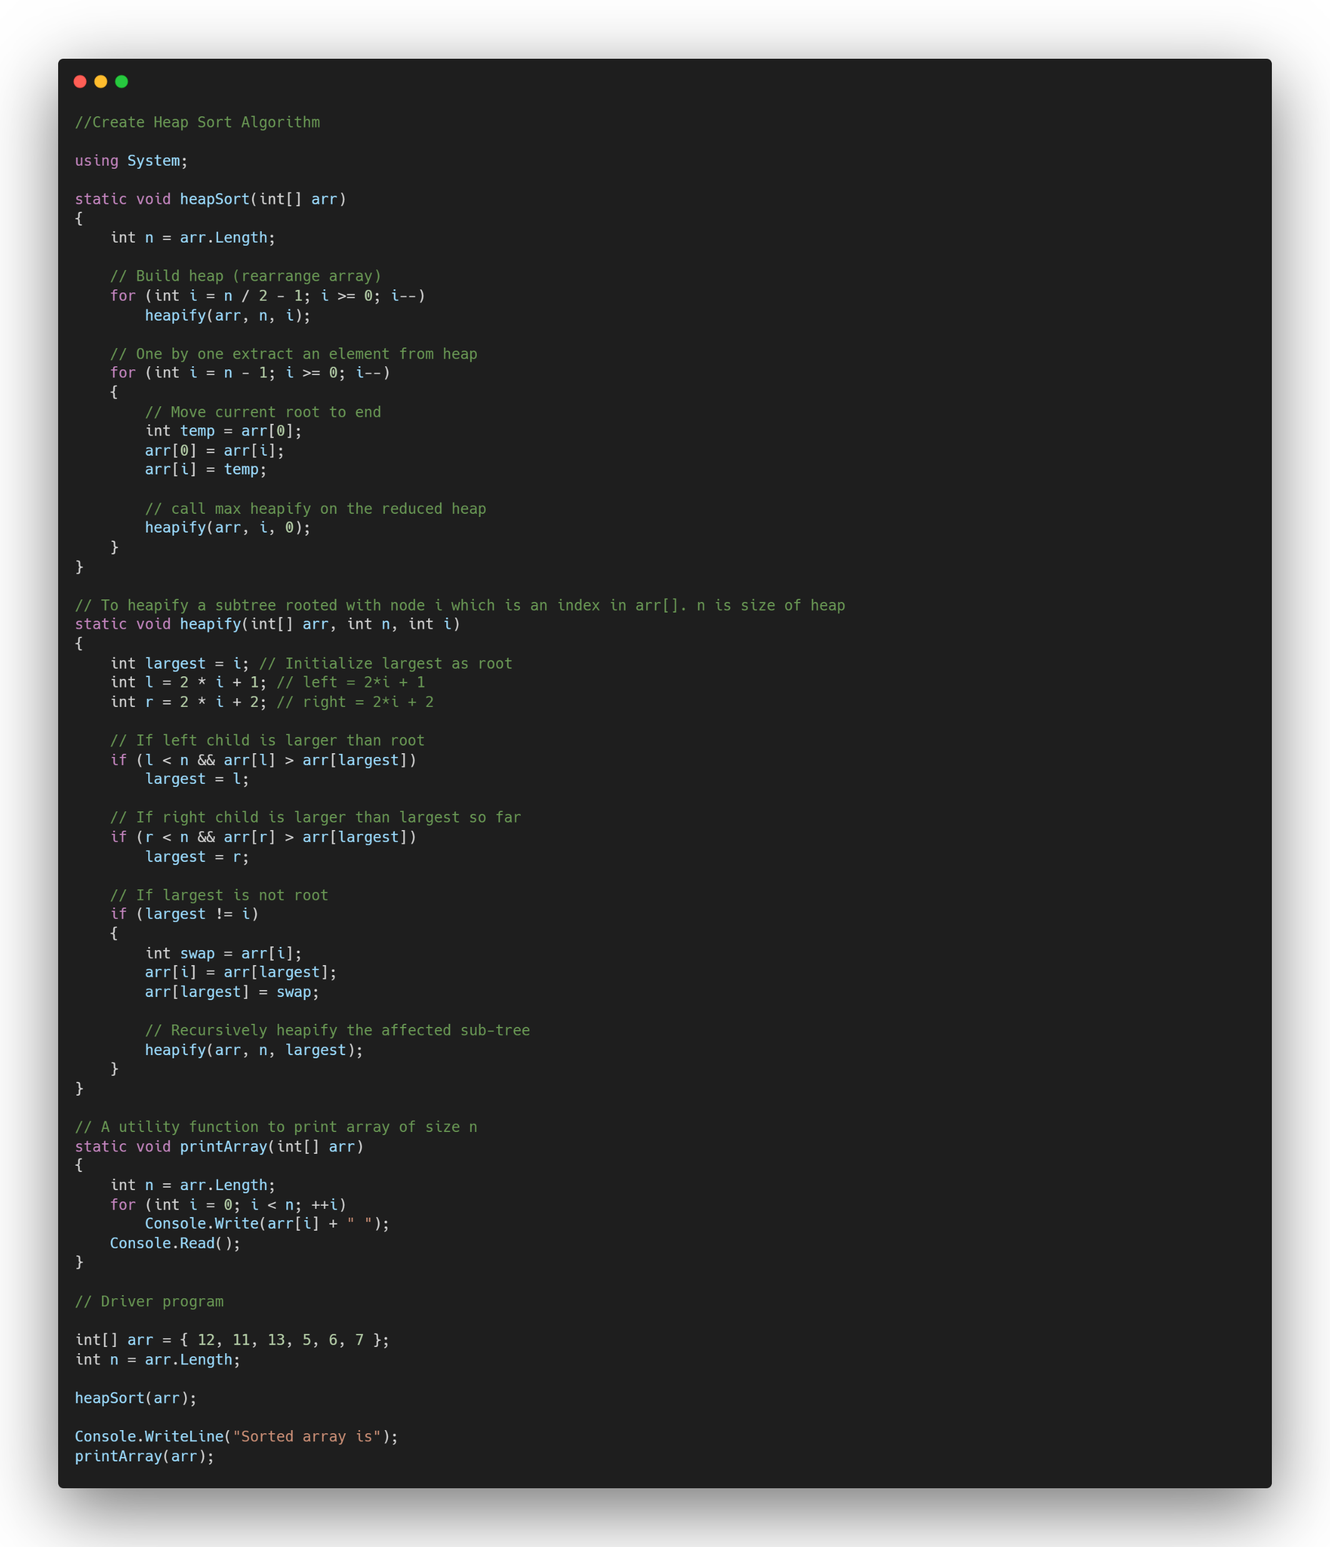
Complexity
Why (not) to Use?
Efficient Time Complexity - O(N log N) is efficient time complexity for a limited input size. After that, CPU operations become too complex and skyrockets.
Memory Usage – Memory usage can be minimal because it doesn’t need additional memory space. This results unstable sorting algorithm.
Simplicity – It’s simple to understand, hard to optimize and program.
Time Complexity: O(N log N)
Input Size
CPU operations

Slide 17
Swap And Remove
Complexity
Why (not) to Use?
Insertion Sort;
Insertion sort is a simple sorting algorithm that the array is virtually split into a sorted and an unsorted part. Values from the unsorted part are picked and placed at the correct position in the sorted part.
Efficient Time Complexity - O(N log N) is efficient time complexity for a limited input size. After that, CPU operations become too complex and skyrockets.
Memory Usage – Memory usage can be minimal because it doesn’t need additional memory space. This results unstable sorting algorithm.
Simplicity – It’s simple to understand, hard to optimize and program.
Time Complexity: O(N log N)
O(n)
How it works?
O(nlogn)
To sort an array of size N in ascending order iterate over the array and compare the current element to its predecessor, if the key element is smaller than its predecessor, compare it to the elements before. Move the greater elements one position up to make space for the swapped element.
CPU operations
1
3
4
5
10
Input Size

Slide 18
Zivar Hasanova
Insertion Sort;
Insertion sort is a simple sorting algorithm that the array is virtually split into a sorted and an unsorted part. Values from the unsorted part are picked and placed at the correct position in the sorted part.
How it works?
To sort an array of size N in ascending order iterate over the array and compare the current element to its predecessor, if the key element is smaller than its predecessor, compare it to the elements before. Move the greater elements one position up to make space for the swapped element.

Slide 19
Insertion Sort;
Insertion sort is a simple sorting algorithm that the array is virtually split into a sorted and an unsorted part. Values from the unsorted part are picked and placed at the correct position in the sorted part.
How it works?
To sort an array of size N in ascending order iterate over the array and compare the current element to its predecessor, if the key element is smaller than its predecessor, compare it to the elements before. Move the greater elements one position up to make space for the swapped element.
Visualization
PASS : 1
12
11
13
5
6

Slide 20
Insertion Sort;
Insertion sort is a simple sorting algorithm that the array is virtually split into a sorted and an unsorted part. Values from the unsorted part are picked and placed at the correct position in the sorted part.
How it works?
To sort an array of size N in ascending order iterate over the array and compare the current element to its predecessor, if the key element is smaller than its predecessor, compare it to the elements before. Move the greater elements one position up to make space for the swapped element.
Visualization
PASS : 1
12
11
13
5
6

Slide 21
Insertion Sort;
Insertion sort is a simple sorting algorithm that the array is virtually split into a sorted and an unsorted part. Values from the unsorted part are picked and placed at the correct position in the sorted part.
How it works?
To sort an array of size N in ascending order iterate over the array and compare the current element to its predecessor, if the key element is smaller than its predecessor, compare it to the elements before. Move the greater elements one position up to make space for the swapped element.
Visualization
PASS : 2
12
13
11
5
6

Slide 22
Insertion Sort;
Insertion sort is a simple sorting algorithm that the array is virtually split into a sorted and an unsorted part. Values from the unsorted part are picked and placed at the correct position in the sorted part.
How it works?
To sort an array of size N in ascending order iterate over the array and compare the current element to its predecessor, if the key element is smaller than its predecessor, compare it to the elements before. Move the greater elements one position up to make space for the swapped element.
Visualization
PASS : 3
13
5
11
12
6

Slide 23
Insertion Sort;
Insertion sort is a simple sorting algorithm that the array is virtually split into a sorted and an unsorted part. Values from the unsorted part are picked and placed at the correct position in the sorted part.
How it works?
To sort an array of size N in ascending order iterate over the array and compare the current element to its predecessor, if the key element is smaller than its predecessor, compare it to the elements before. Move the greater elements one position up to make space for the swapped element.
Visualization
PASS : 3
12
5
11
13
6

Slide 24
Insertion Sort;
Insertion sort is a simple sorting algorithm that the array is virtually split into a sorted and an unsorted part. Values from the unsorted part are picked and placed at the correct position in the sorted part.
How it works?
To sort an array of size N in ascending order iterate over the array and compare the current element to its predecessor, if the key element is smaller than its predecessor, compare it to the elements before. Move the greater elements one position up to make space for the swapped element.
Visualization
PASS : 3
11
5
12
13
6

Slide 25
Insertion Sort;
Insertion sort is a simple sorting algorithm that the array is virtually split into a sorted and an unsorted part. Values from the unsorted part are picked and placed at the correct position in the sorted part.
How it works?
To sort an array of size N in ascending order iterate over the array and compare the current element to its predecessor, if the key element is smaller than its predecessor, compare it to the elements before. Move the greater elements one position up to make space for the swapped element.
Visualization
PASS : 4
13
6
5
11
12

Slide 26
Insertion Sort;
Insertion sort is a simple sorting algorithm that the array is virtually split into a sorted and an unsorted part. Values from the unsorted part are picked and placed at the correct position in the sorted part.
How it works?
To sort an array of size N in ascending order iterate over the array and compare the current element to its predecessor, if the key element is smaller than its predecessor, compare it to the elements before. Move the greater elements one position up to make space for the swapped element.
Visualization
PASS : 4
12
6
5
11
13

Slide 27
Insertion Sort;
Insertion sort is a simple sorting algorithm that the array is virtually split into a sorted and an unsorted part. Values from the unsorted part are picked and placed at the correct position in the sorted part.
How it works?
To sort an array of size N in ascending order iterate over the array and compare the current element to its predecessor, if the key element is smaller than its predecessor, compare it to the elements before. Move the greater elements one position up to make space for the swapped element.
Visualization
PASS : 4
11
6
5
12
13

Slide 28
Insertion Sort;
Insertion sort is a simple sorting algorithm that the array is virtually split into a sorted and an unsorted part. Values from the unsorted part are picked and placed at the correct position in the sorted part.
How it works?
To sort an array of size N in ascending order iterate over the array and compare the current element to its predecessor, if the key element is smaller than its predecessor, compare it to the elements before. Move the greater elements one position up to make space for the swapped element.
Visualization
PASS : 4
5
6
11
12
13

Slide 29
Complexity
Visualization
Why (not) to Use?
PASS : 4
Simple to learn, understand, and implement
Efficient for small data values
Insertion sort takes the maximum time to sort if elements are sorted in reverse order. And it takes minimum time when elements are already sorted.
Time Complexity: O(N^2)
5
6
11
12
13
Input Size
CPU operations

Slide 30
Merge Sort;
Complexity
Why (not) to Use?
Simple to learn, understand, and implement
Efficient for small data values
Insertion sort takes the maximum time to sort if elements are sorted in reverse order. And it takes minimum time when elements are already sorted.
Merge sort is defined as a sorting algorithm that works by dividing an array into smaller subarrays, sorting each subarray, and then merging the sorted subarrays back together to form the final sorted array.
Time Complexity: O(N^2)
How it works?
O(n^2)
O(n)
CPU operations
Merge sort is a recursive algorithm that continuously splits the array in half until it cannot be further divided i.e., the array has only one element left (an array with one element is always sorted). Then the sorted subarrays are merged into one sorted array.
Input Size

Slide 31
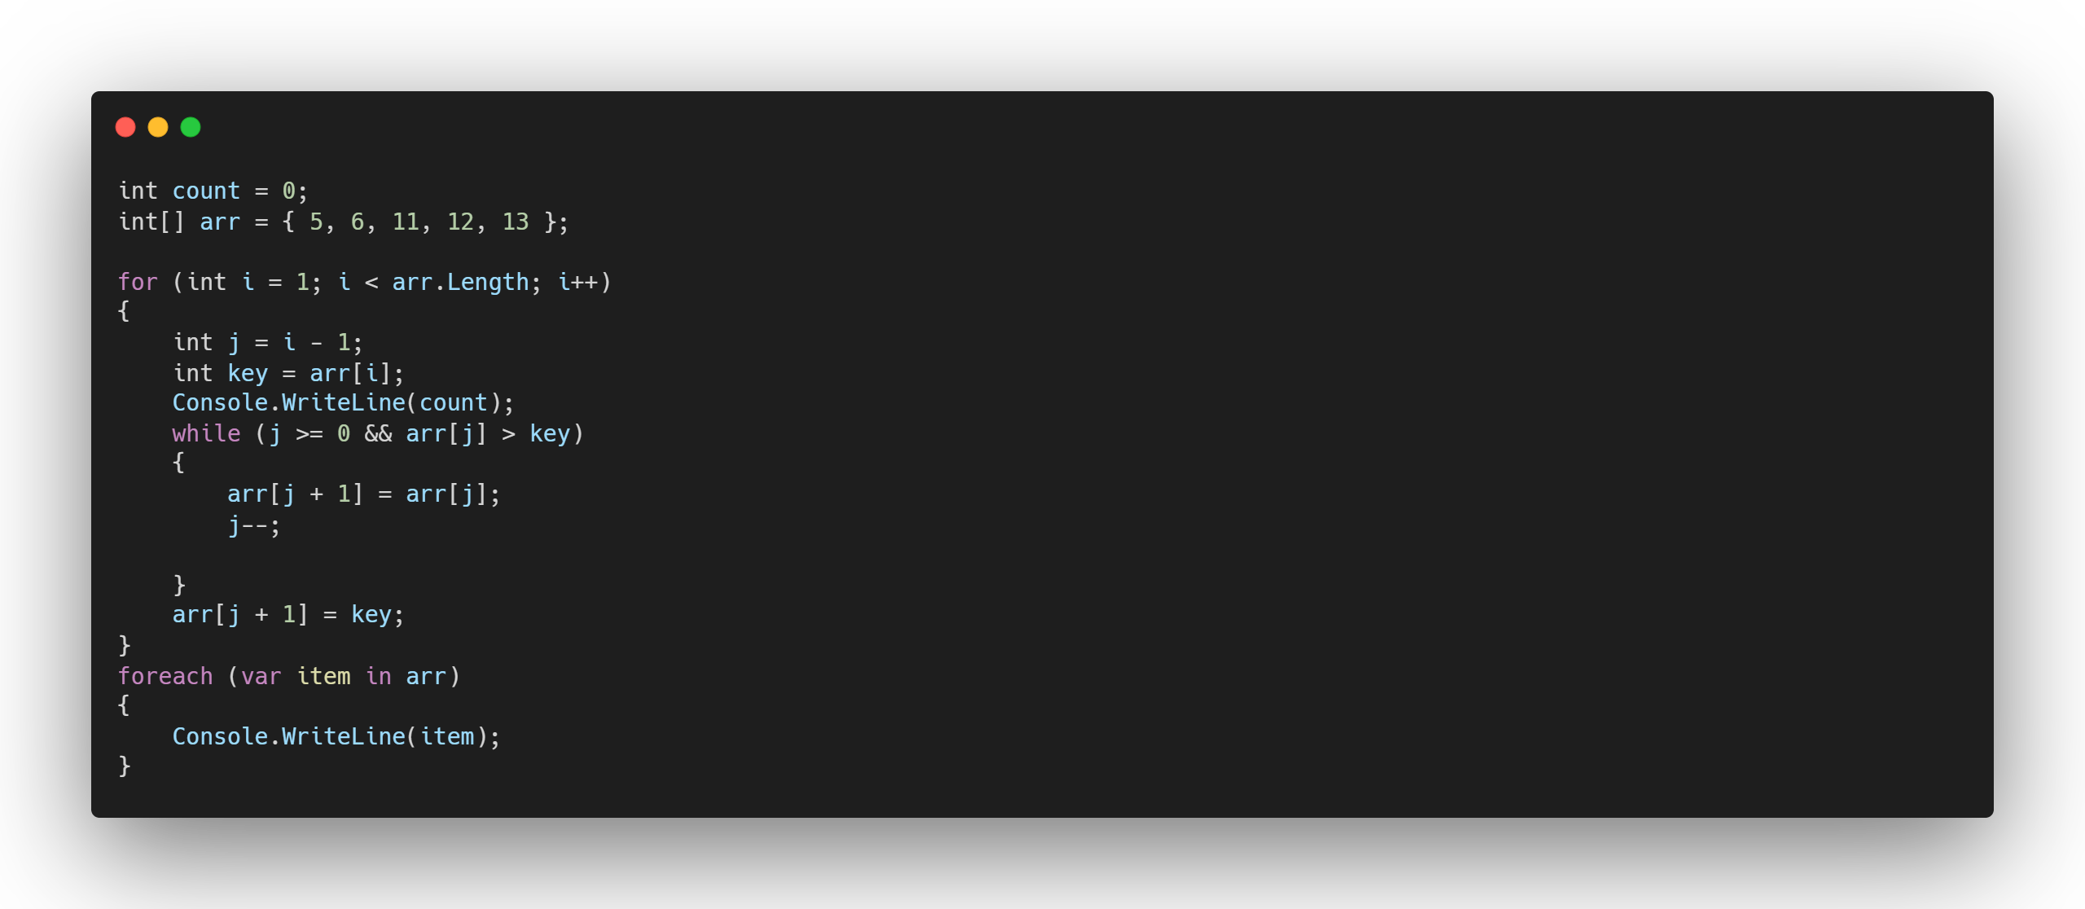
Merge Sort;
Merge sort is defined as a sorting algorithm that works by dividing an array into smaller subarrays, sorting each subarray, and then merging the sorted subarrays back together to form the final sorted array.
How it works?
Merge sort is a recursive algorithm that continuously splits the array in half until it cannot be further divided i.e., the array has only one element left (an array with one element is always sorted). Then the sorted subarrays are merged into one sorted array.

Slide 32
Javidan Alizada
Merge Sort;
Merge sort is defined as a sorting algorithm that works by dividing an array into smaller subarrays, sorting each subarray, and then merging the sorted subarrays back together to form the final sorted array.
How it works?
Merge sort is a recursive algorithm that continuously splits the array in half until it cannot be further divided i.e., the array has only one element left (an array with one element is always sorted). Then the sorted subarrays are merged into one sorted array.

Slide 33
Merge Sort;
Merge sort is defined as a sorting algorithm that works by dividing an array into smaller subarrays, sorting each subarray, and then merging the sorted subarrays back together to form the final sorted array.
How it works?
Merge sort is a recursive algorithm that continuously splits the array in half until it cannot be further divided i.e., the array has only one element left (an array with one element is always sorted). Then the sorted subarrays are merged into one sorted array.
Visualization
38
38
38
27
27
27
43
43
43
10
10
10
Stage: Splitting

Slide 34
Visualization
38
27
43
10
38
38
27
27
43
43
10
10
Stage: Splitting

Slide 35
38
27
43
10
Visualization
38
27
43
10
38
27
43
10
Stage: Splitting

Slide 36
38
27
43
10
Visualization
38
27
43
10
Stage: Merging

Slide 37
Visualization
27
38
10
43
Stage: Merging

Slide 38
Why (not) to Use?
Stability: Merge sort is a stable sorting algorithm, which means it maintains the relative order of equal elements in the input array.
Guaranteed worst-case performance: Merge sort has a worst-case time complexity of O(N logN), which means it performs well even on large datasets.
Parallelizable: Merge sort is a naturally parallelizable algorithm, which means it can be easily parallelized to take advantage of multiple processors or threads.
Space complexity and Not Optimal for small datasets: Merge sort requires additional memory to store the merged sub-arrays during the sorting process. Also, it requires higher time complexity for smaller datasets.
Complexity
Time Complexity: O(N log N)
Auxiliary Space: O(N)
Visualization
10
27
38
43
Stage: Merging
Input Size
CPU operations

Slide 39
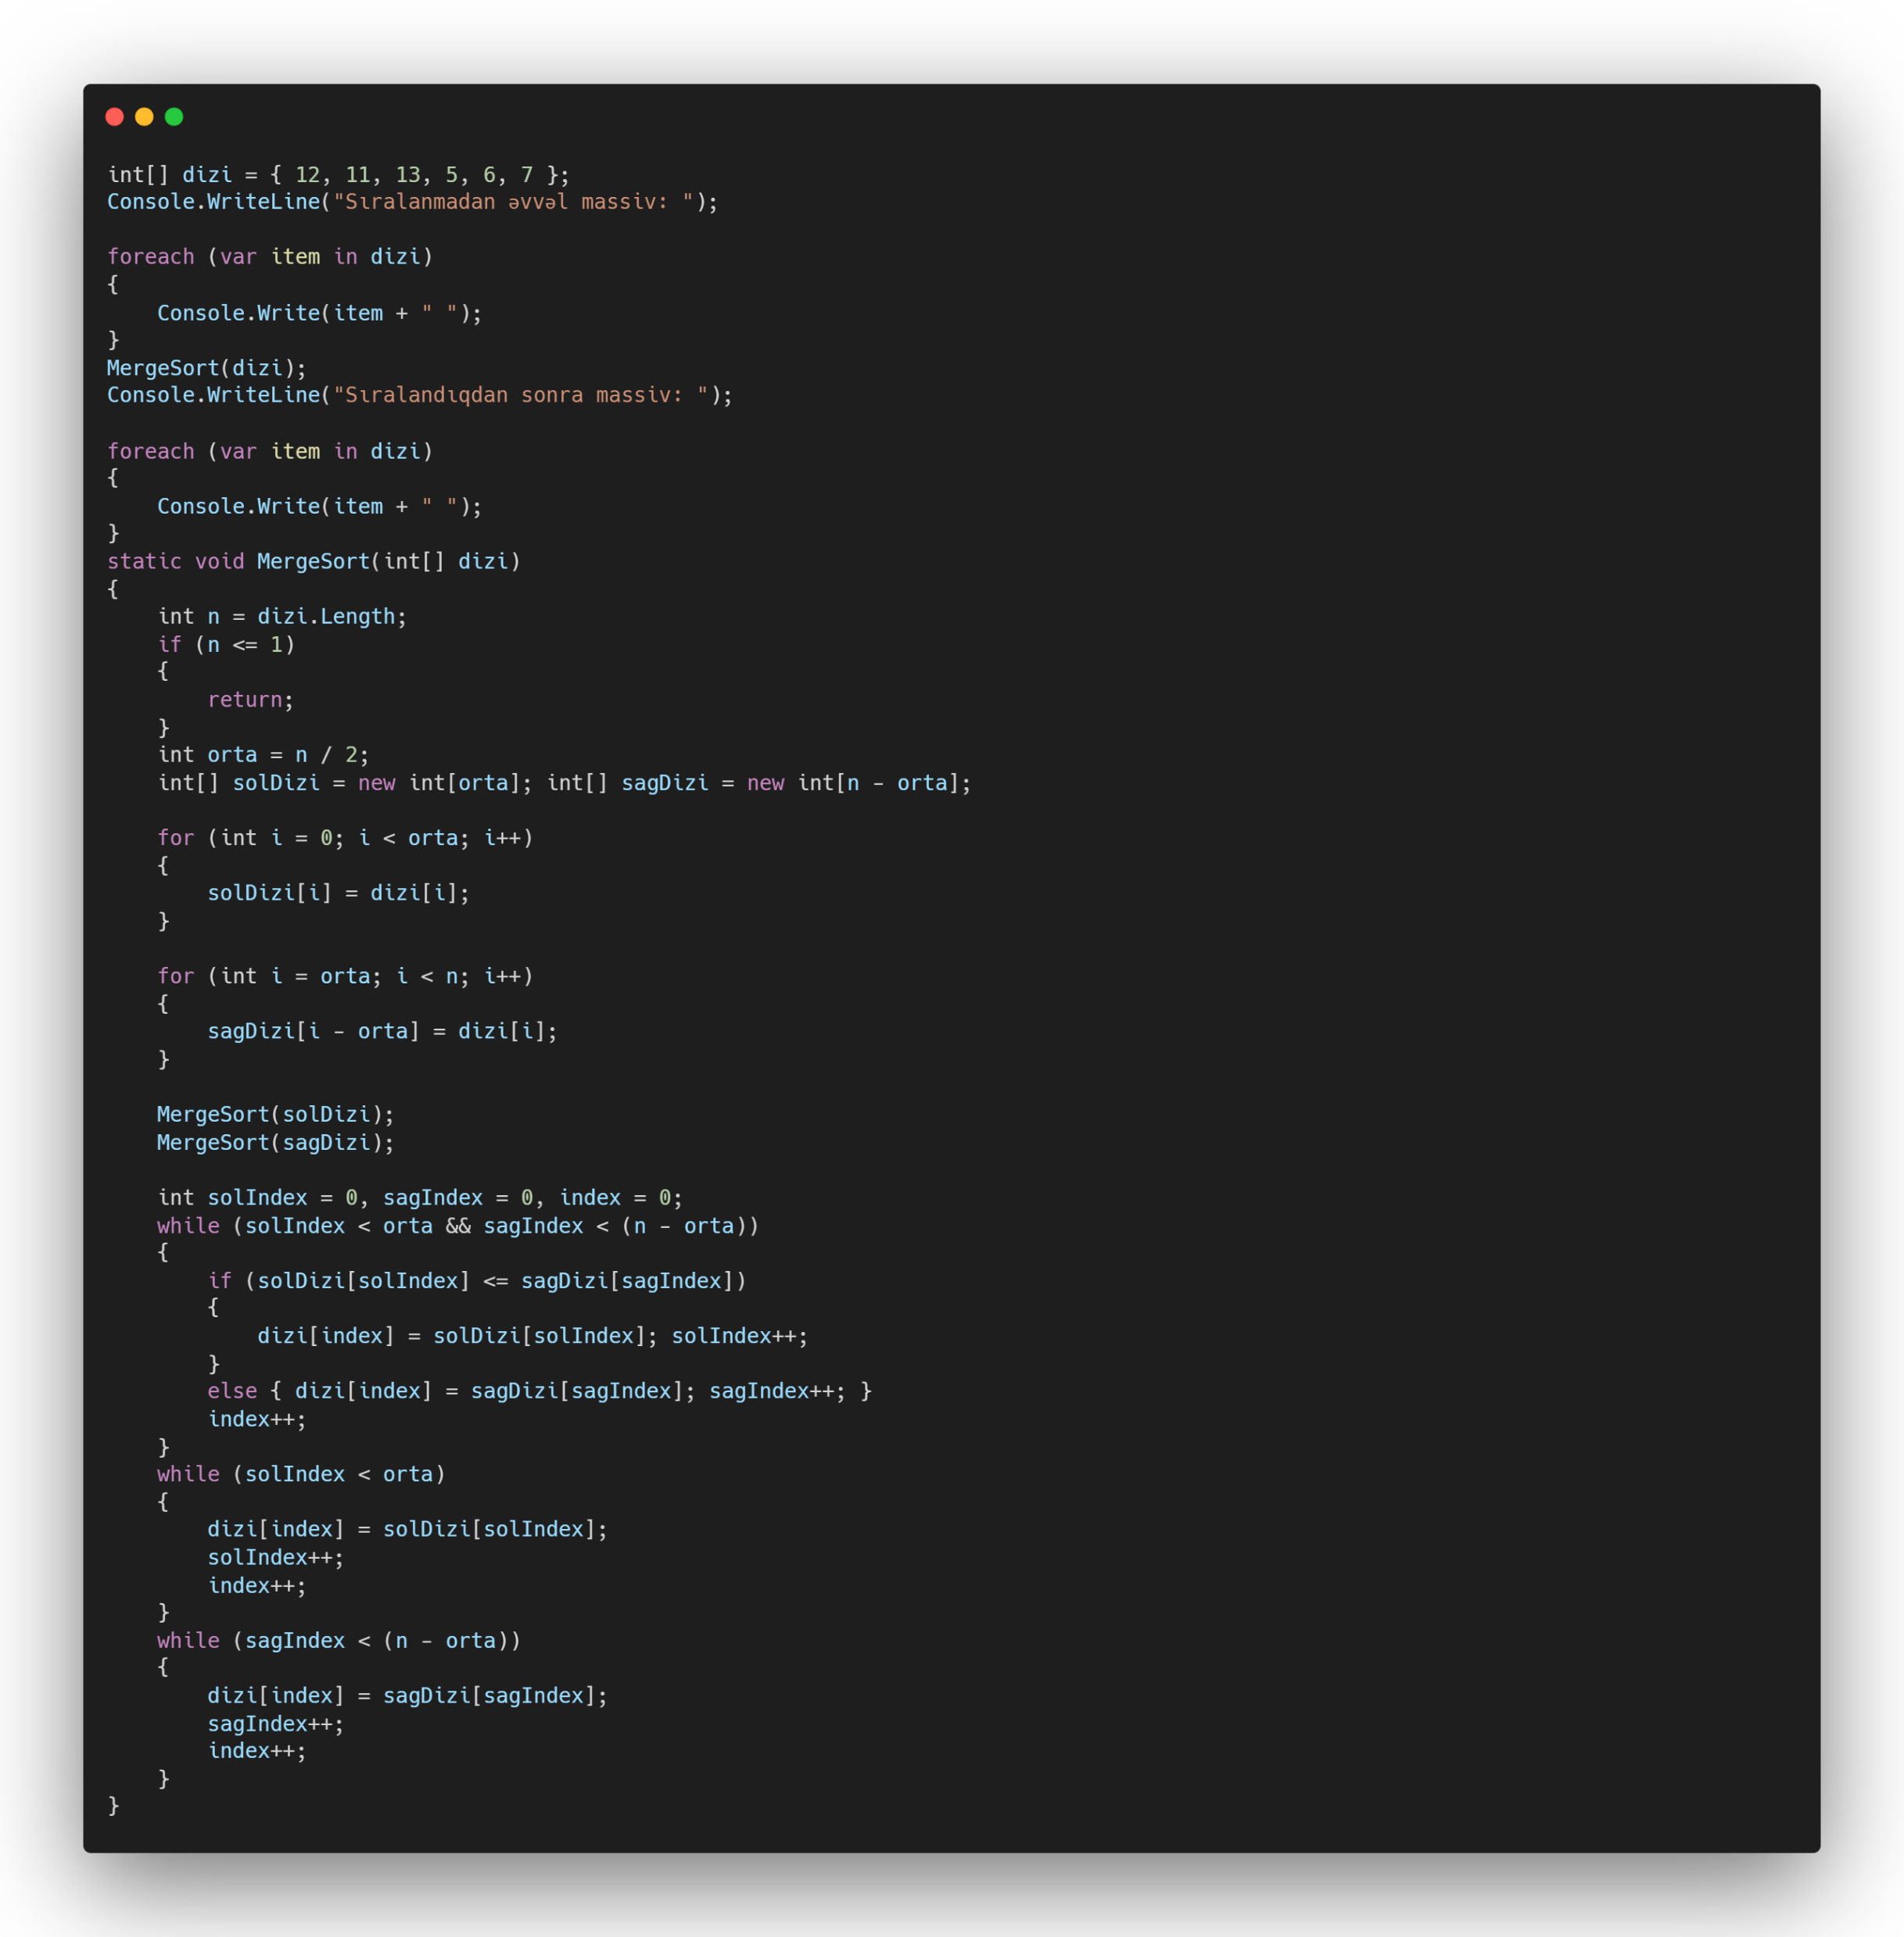
Why (not) to Use?
Stability: Merge sort is a stable sorting algorithm, which means it maintains the relative order of equal elements in the input array.
Guaranteed worst-case performance: Merge sort has a worst-case time complexity of O(N logN), which means it performs well even on large datasets.
Parallelizable: Merge sort is a naturally parallelizable algorithm, which means it can be easily parallelized to take advantage of multiple processors or threads.
Space complexity and Not Optimal for small datasets: Merge sort requires additional memory to store the merged sub-arrays during the sorting process. Also, it requires higher time complexity for smaller datasets.
Complexity
Time Complexity: O(N log N)
Auxiliary Space: O(N)
Input Size
CPU operations

Slide 40
Selection Sort;
Complexity
Why (not) to Use?
Time Complexity: O(N log N)
Stability: Merge sort is a stable sorting algorithm, which means it maintains the relative order of equal elements in the input array.
Guaranteed worst-case performance: Merge sort has a worst-case time complexity of O(N logN), which means it performs well even on large datasets.
Parallelizable: Merge sort is a naturally parallelizable algorithm, which means it can be easily parallelized to take advantage of multiple processors or threads.
Space complexity and Not Optimal for small datasets: Merge sort requires additional memory to store the merged sub-arrays during the sorting process. Also, it requires higher time complexity for smaller datasets.
Selection sort is a simple and efficient sorting algorithm that works by repeatedly selecting the smallest (or largest) element from the unsorted portion of the list and moving it to the sorted portion of the list.
Auxiliary Space: O(N)
How it works?
O(n)
O(nlogn)
CPU operations
The algorithm repeatedly selects the smallest (or largest) element from the unsorted portion of the list and swaps it with the first element of the unsorted part. This process is repeated for the remaining unsorted portion until the entire list is sorted.
Input Size

Slide 41
Gunel Khanaliyeva
Selection Sort;
Selection sort is a simple and efficient sorting algorithm that works by repeatedly selecting the smallest (or largest) element from the unsorted portion of the list and moving it to the sorted portion of the list.
How it works?
The algorithm repeatedly selects the smallest (or largest) element from the unsorted portion of the list and swaps it with the first element of the unsorted part. This process is repeated for the remaining unsorted portion until the entire list is sorted.

Slide 42
Selection Sort;
Selection sort is a simple and efficient sorting algorithm that works by repeatedly selecting the smallest (or largest) element from the unsorted portion of the list and moving it to the sorted portion of the list.
How it works?
The algorithm repeatedly selects the smallest (or largest) element from the unsorted portion of the list and swaps it with the first element of the unsorted part. This process is repeated for the remaining unsorted portion until the entire list is sorted.
Visualization
64
25
12
22
11

Slide 43
Visualization
11
64
25
12
22
Find the lowest value

Slide 44
Visualization
64
11
25
12
22
Swap with the first position

Slide 45
Visualization
11
25
12
22
64
Swap with the first position

Slide 46
Visualization
12
11
25
22
64
Find the lowest value

Slide 47
Visualization
25
12
11
22
64
Swap with the second position

Slide 48
Visualization
11
12
25
22
64
Swap with the second position

Slide 49
Visualization
22
11
12
25
64
Find the lowest value

Slide 50
Visualization
25
22
11
12
64
Swap with the third position

Slide 51
Visualization
11
12
22
25
64
Swap with the third position

Slide 52
Complexity
Time Complexity: O(N^2)
Visualization
11
12
22
25
64
Next lowest value is at the place, so no swap will occur.
Input Size
CPU operations

Slide 53
Complexity
Why (not) to Use?
Simple to learn, understand, and implement.
Efficient for small data values.
Having O(N^2) as time complexity for worst and average case is one of the disadvantages of Selection Sort.
On Large Datasets, not preferred to use.
It’s unstable sorting algorithm, so it means equal keys will not preserve the relative order.
Time Complexity: O(N^2)
O(n^2)
O(n)
CPU operations
Input Size

Slide 54
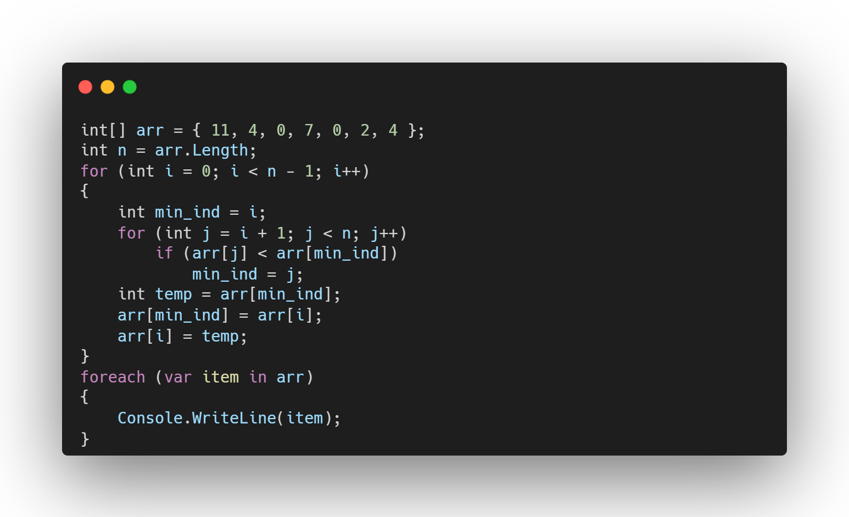
Complexity
Why (not) to Use?
Simple to learn, understand, and implement.
Efficient for small data values.
Having O(N^2) as time complexity for worst and average case is one of the disadvantages of Selection Sort.
On Large Datasets, not preferred to use.
It’s unstable sorting algorithm, so it means equal keys will not preserve the relative order.
Time Complexity: O(N^2)
O(n^2)
O(n)
CPU operations
Input Size

Slide 55
End Of Searching Algorithms Thank you for listening! :3
Codes can be found in my Repo: https://github.com/AVMiraga/Sorting_And_Searching

